Slide 1
Prediction of HIV Viral Suppression Status Using Support Vector Machines
Group 3 Participants
Name | Student Number
Deogratius
Aceng Irene
James
Kyomuhendo Milliam | 2301200747

Slide 2
Introduction
According to WHO, HIV is still a major global public health issue, claiming 42.3 million lives so far since it emerged. However, efforts are being made to towards ensuring that 95% of people living with HIV should know their HIV status, are on ART and are virally suppressed

Slide 3
Introduction
Machine Learning methods can be used to predict the viral load suppression given the demographic data and treatment adherence data enabling faster HIV-related interventions to prevent new infections and ensure that an optimal level of suppression is achieved.

Slide 4
Proposed Model
A Support Vector Machine was proposed to predict whether a patient will achieve viral suppression based on demographic, and clinical data. This is because HIV-related data is subjected to non-linear relationships among the features.

Slide 5
Data Cleaning
All features containing personal identifiable information were removed to ensure privacy is preserved.
Only samples with HIV-positive status and on ART were considered for this study.
All samples with missing values were eliminated from the dataset
Only features related to demographic data and like, Age, Weight, Date of Enrollment on ART, and Date of Last Viral Load bleeding were considered in this study

Slide 6
Data Cleaning
Data Preprocessing
The Date of Enrollment on ART and Date of Last Viral Load bleeding were used to generate a new feature that is Years on ART that would be used to contribute to the prediction of suppression status.
Feature Selection
Two features were selected to predict the suppression status based on experience of the researchers i.e. Age and Years on ART.

Slide 7

Data Cleaning
Splitting
80% Training and 20% Testing
Feature Normalization
Z-Score Normalization
Where:
Μ is the Mean of the feature
Σ is the Standard deviation of the feature

Slide 8
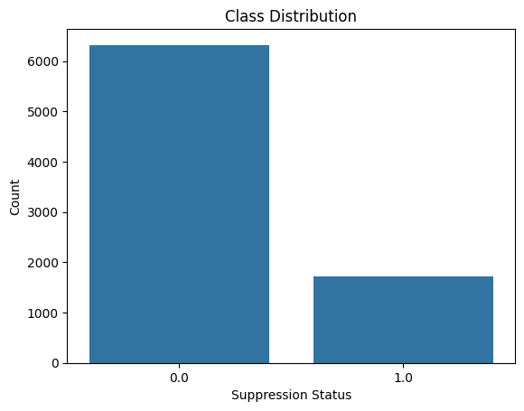
Data Visualization
Class Distribution Visualization
The unbalanced class distribution was solved by assigning the class weights as balanced during Model Training

Slide 9
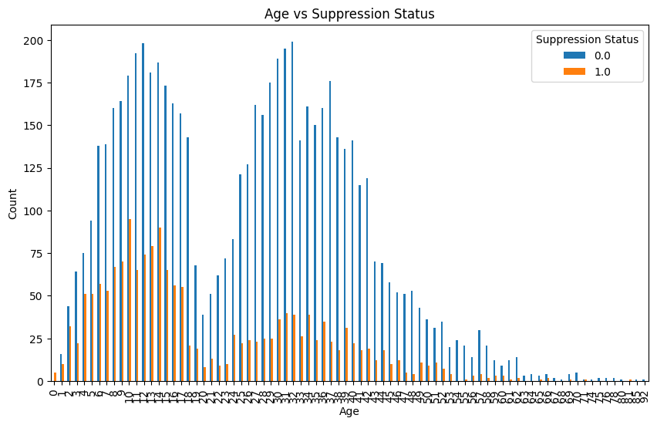
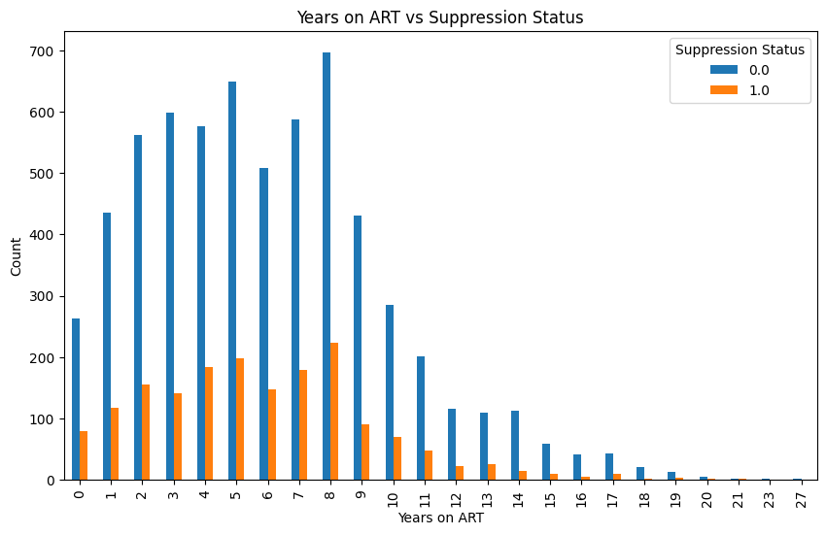
Data Visualization
Relationship between Age and Suppression Status
Relationship between Years on ART and Suppression Status

Slide 10
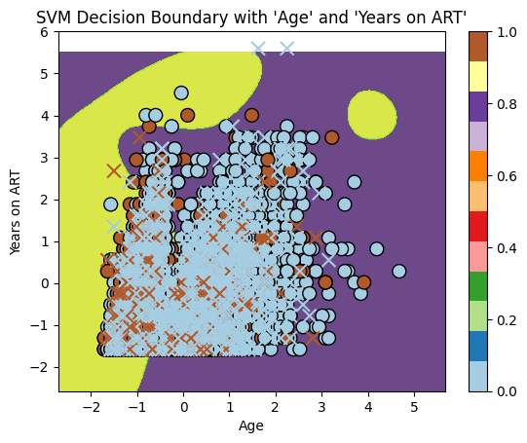
The Model

